Slide 1
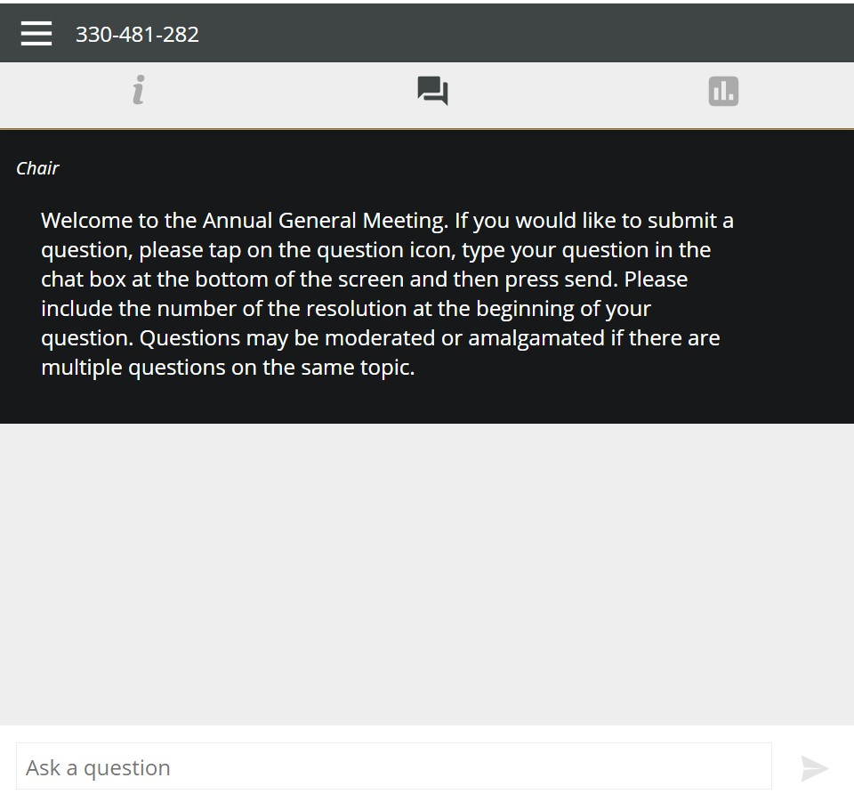
ONLINE Attendees – Question PROCESS
When the Question function is available, the Q&A icon will appear at the top of the app
To send in a question, click in the ‘Ask a question’ box, type your question and press the send arrow
Your question will be sent immediately for review
Received

Slide 2
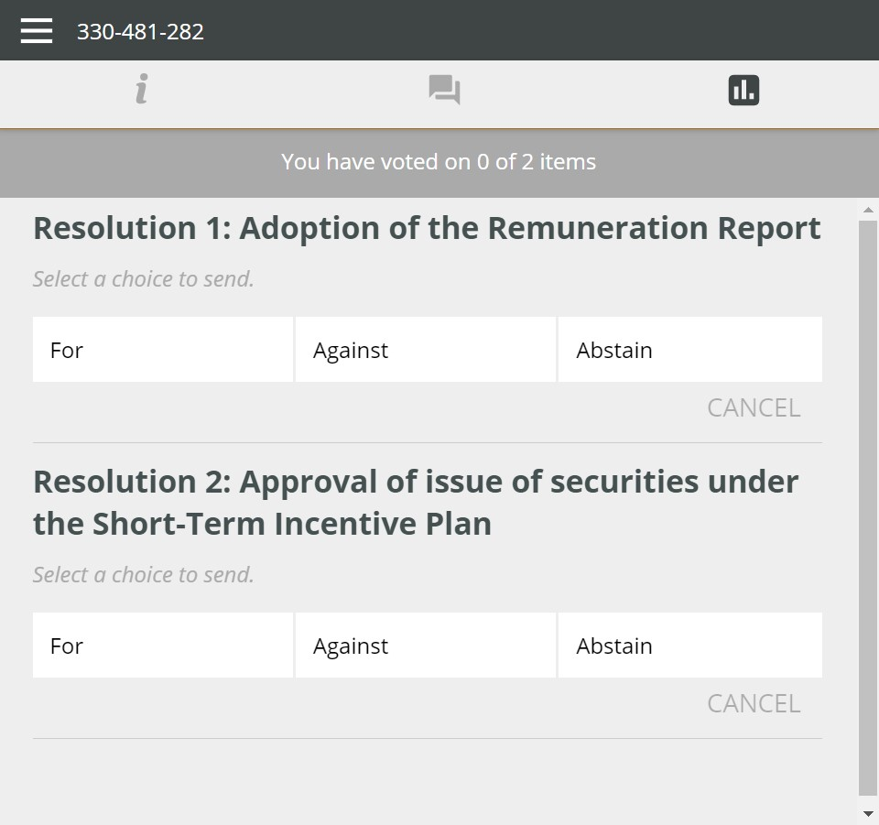
ONLINE Attendees – VOTING PROCESS
When the poll is open, the vote will be accessible by selecting the voting icon at the top of the screen
To vote simply select the direction in which you would like to cast your vote. The selected option will change colour
For
Against
Abstain
There is no submit or send button, your selection is automatically recorded. You can change your mind or cancel your vote any time before the poll is closed

